Slide 1

Facial Expressions Detection System Using AI Based Techniques
SUBMITTED BY:-
ADITYA RAWAT & EDWIN

Slide 2
Contents
Abstract
Introduction
Objective
Problem Definition
Technologies Used
System Architecture
Plan Of Work
Implementation

Slide 3
Contents
Result
Conclusion
Future Scope
References

Slide 4
Abstract
Human facial expressions convey a lot of information visually rather than articulately. Facial expression recognition plays a crucial role in the area of human-machine interaction. Automatic facial expression recognition system has many applications including, Personal identification and Access control, Videophone and Teleconferencing, Forensic application, Human-Computer Interaction, Automated Surveillance, Cosmetology, Human Behavior Understanding, Detection Of Mental Disorders, And Synthetic Human Expressions.
The objective of this project is to develop Automatic Facial Expression Recognition System which can take human facial images containing some expression as input and recognize and classify it into seven different expression class such as :
I. Neutral II. Angry III. Disgust IV. Fear V. Happy VI. Sadness VII. Surprise

Slide 5
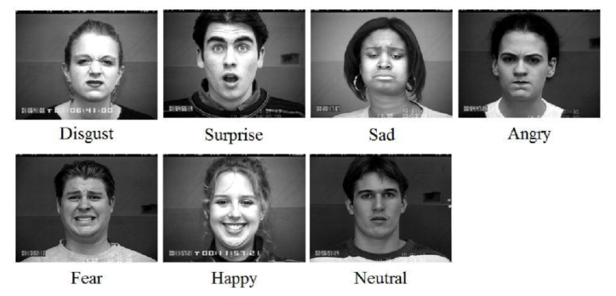
Introduction
Facial expression recognition is the process of identifying human emotion. Our emotion is revealed by the expressions in our face. Facial Expressions plays an important role in interpersonal communication. Facial expression is a non verbal scientific gesture which gets expressed in our face as per our emotions.
Two popular methods utilized mostly in the literature for the automatic FER systems are based on geometry and appearance.

Slide 6
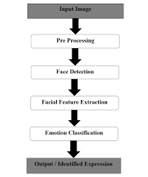
In this project we applied various deep learning methods (convolutional neural networks) to identify the key seven human emotions: anger, disgust, fear, happiness, sadness, surprise and neutrality.
Facial Expression Recognition usually performed in four-stages consisting:
Dataset preprocessing
Face detection
Feature extraction
Classification based on the features

Slide 7
Objective
The objective of face emotion recognition (FER) is identifying emotions of a human such as happy, anger, disgust, fear, sadness, and surprise which can be further used in other applications like the ones given below:
Psychological characteristics such as heartbeat and blood Pressure, speech, hand gestures, body movements, Facial expressions identify emotions of a person.
It can be used as a part of many interesting and useful applications like Monitoring security, treating patients in medical field, marketing research, E-learning etc.
The ability for a computer to recognize human emotion has many highly valuable real world applications. Consider the domain of therapy robots which are designed to provide care and comfort for infirm and disabled individuals.
It can be used for the benefit of physically handicapped people like deaf and dumb. Using which other people or an automated system can understand their needs by observing their facial expression.

Slide 8
Problem Definition
Human facial expressions can be easily classified into 7 basic emotions: happy, sad, surprise, fear, anger, disgust, and neutral. Our facial emotions are expressed through activation of specific sets of facial muscles. These sometimes subtle, yet complex, signals in an expression often contain an abundant amount of information about our state of mind. Through facial emotion recognition, we are able to measure the effects that content and services have on the audience/users through an easy and low-cost procedure. For example, retailers may use these metrics to evaluate customer interest. Healthcare providers can provide better service by using additional information about patients' emotional state during treatment. Entertainment producers can monitor audience engagement in events to consistently create desired content.
Humans are well-trained in reading the emotions of others, in fact, at just 14 months old, babies can already tell the difference between happy and sad. But can computers do a better job than us in accessing emotional states? To answer the question, We designed a deep learning neural network that gives machines the ability to make inferences about our emotional states. In other words, we give them eyes to see what we can see.

Slide 9
Technologies Used
Anaconda
It is a free and open source distribution of the Python and R programming languages for data science and machine learning related applications, that aims to simplify package management and deployment.
Jupyter Notebook
It is an open-source web application that allows you to create and share documents that contain live code, equations, visualizations and narrative text.
Google Colab
It allows anybody to write and execute arbitrary python code through the browser, and is especially well suited to machine learning, data analysis and education.
Python
Python is a powerful scripting language and is very useful for solving statistical problems involving machine learning algorithms. It has various utility functions which help in preprocessing. It provides the pandas and numpy framework which helps in manipulation of data as per our need.

Slide 10
Libraries And Packages
OpenCV
OpenCV (Open Source Computer Vision Library) is an open source computer vision and machine learning software library. OpenCV was built to provide a common infrastructure for computer vision applications and to accelerate the use of machine perception in the commercial products.
Numpy
NumPy is an acronym for "Numeric Python" or "Numerical Python". It is an open source extension module for Python, which provides fast precompiled functions for mathematical and numerical routines.
Haar Cascade Classifier in OpenCv
It is a machine learning based approach where a cascade function is trained from a lot of positive and negative images. It is then used to detect objects in other images.Here we will work with face expression detection.
Keras
Keras is a high-level neural networks API, written in Python and capable of running on top of TensorFlow, CNTK, or Theano. It was developed with a focus on enabling fast experimentation.
TensorFlow
TensorFlow is a Python library for fast numerical computing created and released by Google. It is a foundation library that can be used to create Deep Learning models directly or by using wrapper libraries that simplify the process built on top of TensorFlow.

Slide 11
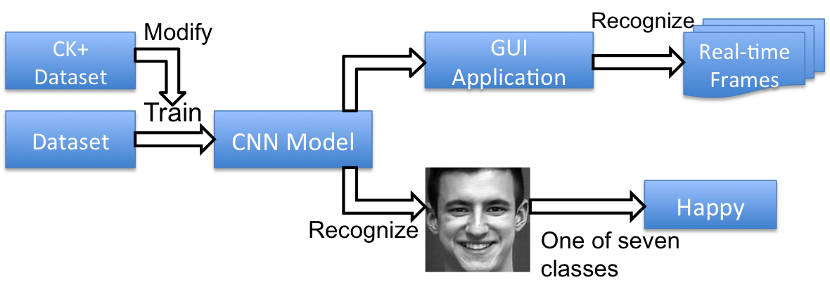
System Architecture

Slide 12
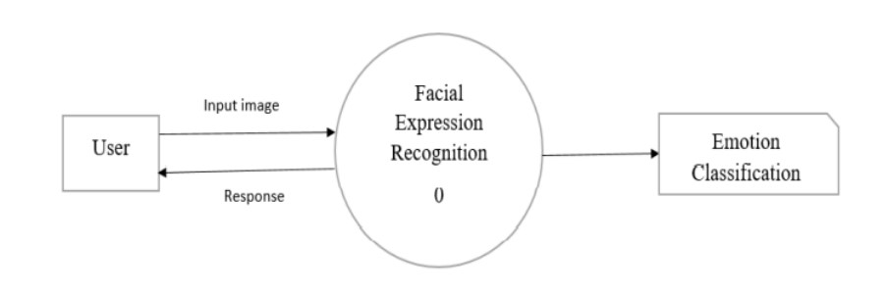
DFD LEVEL 0:

Slide 13
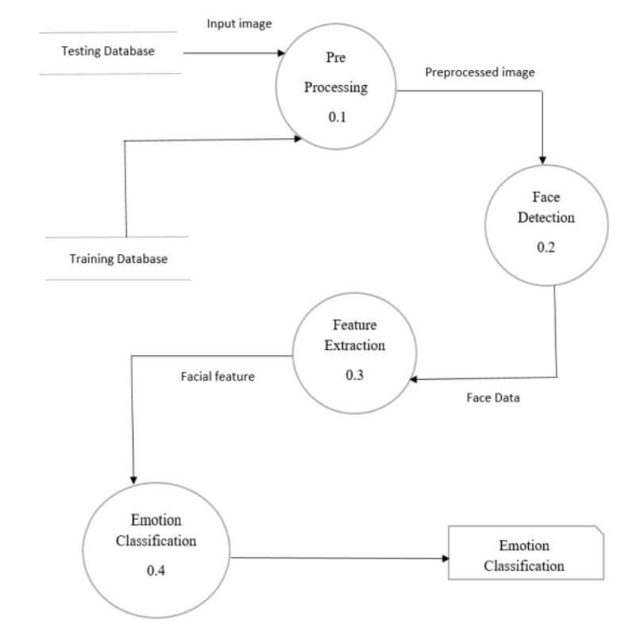
DFD LEVEL 1:

Slide 14
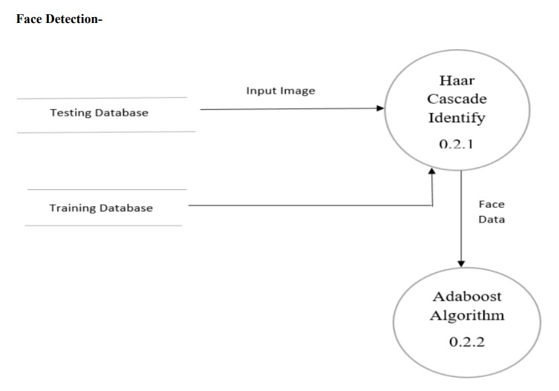
DFD LEVEL 3:

Slide 15
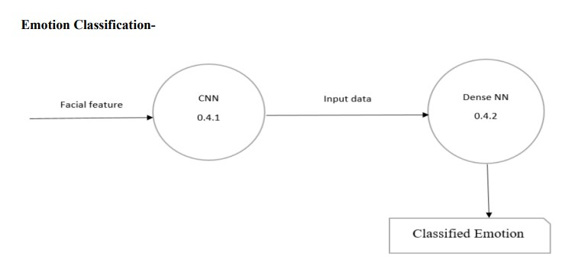
DFD LEVEL 5:

Slide 16
Plan Of Work
Analysis of the problem statement.
Gathering of the requirement specification
Analyzation of the feasibility of the project.
Development of a general layout.
Going by the journals regarding the previous related works on this field.
Choosing the method for developing the algorithm.
Analyzing the various pros and cons.
Starting the development of the project.

Slide 17
Plan Of Work
Installation of software like ANACONDA.
Developing an algorithm.
Analyzation of algorithm by guide.
Coding as per the developed algorithm in PYTHON.

Slide 18
Implementation
The Dataset
The dataset we used for training the model is from a Kaggle Facial Expression Recognition (FER2013). It comprises a total of 35887 images of faces which are in .csv format, each labeled with one of the 7 emotion classes: anger, disgust, fear, happiness, sadness, surprise, and neutral
The Model
Deep learning is a popular technique used in computer vision. We chose Convolutional Neural Network (CNN) layers as building blocks to create our model architecture. CNNs are known to imitate how the human brain works when analyzing visuals.
Input Layer
The input layer has pre-determined, fixed dimensions, so the image must be pre-processed before it can be fed into the layer. We used OpenCV, a computer vision library, for face detection in the image. The haarcascade_frontalface_default.xml in OpenCV contains pre-trained filters and uses Adaboost to quickly find and crop the face.

Slide 19
Convolutional Layers
Convolution generates feature maps that represent how pixel values are enhanced, for example, edge and pattern detection. A feature map is created by applying filter 1 across the entire image. Other filters are applied one after another creating a set of feature maps.
Dense Layers
The dense layer (aka fully connected layers), is inspired by the way neurons transmit signals through the brain. It takes a large number of input features and transform features through layers connected with trainable weights. These weights are trained by forward propagation of training data then backward propagation of its errors.
Output Layer
This output presents itself as a probability for each emotion class. Therefore, the model is able to show the detail probability composition of the emotions in the face. As later on, you will see that it is not efficient to classify human facial expression as only a single emotion. Our expressions are usually much complex and contain a mix of emotions that could be used to accurately describe a particular expression.
Model Validation
Performance As it turns out, the final CNN had a validation accuracy of 63.4%. This actually makes a lot of sense. Because our expressions usually consist a combination of emotions, and only using one label to represent an expression can be hard.

Slide 20
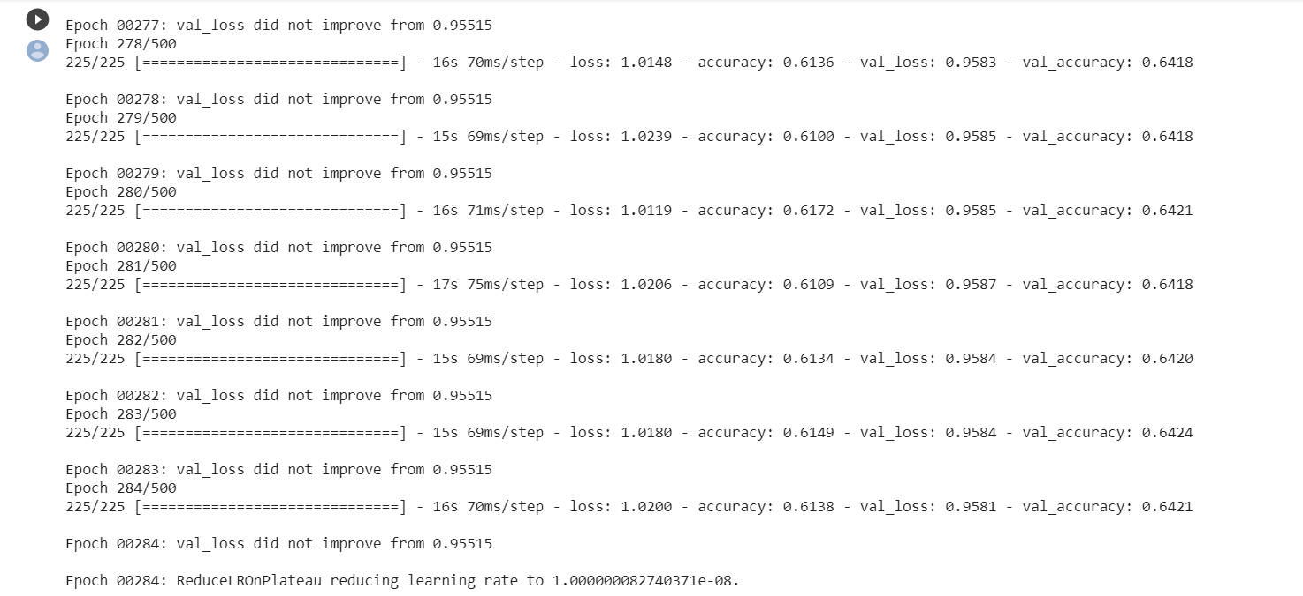
Result
Dataset Trained Successfully

Slide 21
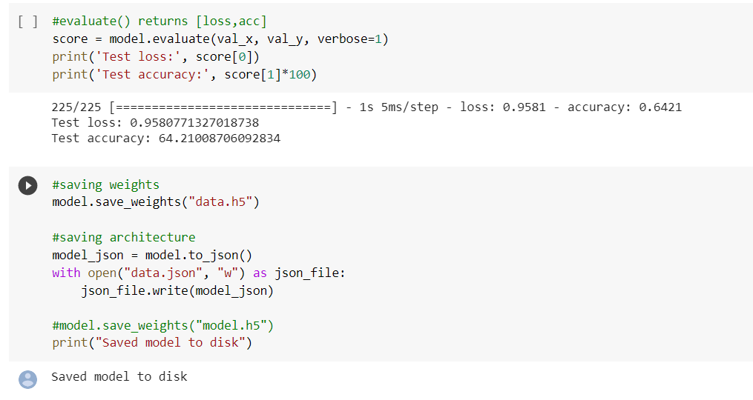
Accuracy Check Of The Model & Json Model Created Succesfully

Slide 22
Future Scope
It is important to note that there is no specific formula to build a neural network that would guarantee to work well. Different problems would require different network architecture and a lot of trail and errors to produce desirable validation accuracy.
In this project we got an accuracy of almost 64.2% but due to lack of highly configured system we could not go deeper into dense neural network as the system gets very slow and we will try to improve in these areas in future.
We would also like to train more databases into the system to make the model more accurate but again resources becomes a hindrance in the path.
We can use this system to detect deepfake crime.
We can use this system to prevent driving accidents by detecting whether driver’s eyes are open or not.

Slide 23
Help people in emotion-related research to improve the processing of emotion data.
Patient Monitoring in hospitals to judge the effectiveness of prescribed drugs is one application to the Health Sector.
It can be used for the benefit of physically handicapped people like deaf and dumb. Using which other people or an automated system can understand their needs by observing their facial expression.

Slide 24
Conclusion
In this project, We studied that what are the techniques used previously which mentioned in technologies used, what are the real time application for the proposed system which covered in objective and motivation.
By using the mentioned dataset the neural network will be trained and by adding maximum hidden layer i.e. with deep layer in convolutional network the result will be calculated. It covers the concept of facial expression recognition with aimed to classify images of faces into any of seven discrete emotion or face expression categories that represent universal human emotions.
The facial expression recognition system presented in this work contributes a resilient face recognition model based on the mapping of behavioral characteristics with the physiological biometric characteristics. The physiological characteristics of the human face with relevance to various expressions such as happiness, sadness, fear, anger, surprise and disgust are associated with geometrical structures which restored as base matching template for the recognition system.
When the model predicts incorrectly, the correct label is often the second most likely emotion.

Slide 25
References
A literature survey on Facial Expression Recognition using Global Features by Vaibhav kumar, J. Mistry and Mahesh M. Goyani, International Journal of Engineering and Advanced Technology (IJEAT),April,2013 [http://citeseerx.ist.psu.edu/viewdoc/download?doi=10.1.1.645.5162&rep=rep1&type=pdf]
Convolutional Neural Networks (CNN) With TensorFlow by Sourav from Edureka [https://www.youtube.com/watch?v=umGJ30-15_A]
Deep Learning Simplified by Sourav from Edureka [https://www.youtube.com/watch?v=dafuAz_CV7Q&list=PL9ooVrP1hQOEX8BKDplfG86ky8s7Oxbzg]
“Robust Real-Time Face Detection”, International Journal of Computer Vision 57(2), 137–154, 2004

Slide 26
VIOLA JONES FACE DETECTION EXPLAINATION by Rahul Patil.
Project_Report_On_FACIAL_EXPRESSION_RECOGNITION_USING_IMAGE_PROCESSING
Facial Expression Detection Techniques: Based on Viola and Jones algorithm and Principal Component Analysis by Samiksha Agrawal and Pallavi Khatri, ITM University Gwalior(M.P.), India, 2014.
Online publication on Convolutional Neural Networks: An Intro Tutorial by Derrick Mwiti [https://heartbeat.fritz.ai/a-beginners-guide-to-convolutional-neural-networks-cnn-cf26c5ee17ed]

Slide 27
THANK YOU

